Slide 1



AI POWERED PERSONAL FITNESS & LIFESTYLE ADVISOR
(MEDICAL NUTRITION APP)
Page 01

Slide 2
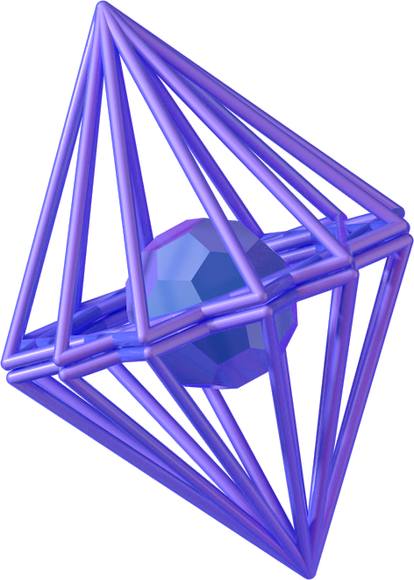
Agenda
Introduction
Brief about First Discussion
Problem Statement
Key Features
Research Papers
System Requirements
Methodology
Dataset
Ai Models
Application
Website
Conclusion
Page 02

Slide 3
Introduction
A smart application designed to improve users' quality of life and overall health.
Utilizes AI and data analysis to provide personalized health recommendations.
Tracks physical activity, dietary habits, and offers customized nutritional advice.
Integrates Machine Learning techniques for accurate health insights.
Built on a robust dataset that includes BMI and various lifestyle patterns.
Page 04

Slide 4
Problem Statement
Staying healthy is difficult due to:
Lack of time to plan meals or workouts
Inconsistent motivation and progress tracking
Limited access to personalized health advice
Difficulty in finding nearby fitness facilities Our app solves these issues with AI-driven solutions.
Key Features
Personalized health profile
Activity and sleep tracking
AI-powered diet recommendations
Custom workout plans
Motivational notifications
AI Chatbot for health guidance
Gym locator & health news integration
Integration with Google Fit / Apple Health

Slide 5
Research Papers
We studied 5 AI research papers related to:
AI in nutrition
AI fitness trainer with pose detection
Real-time posture correction
Disease prediction using wearable data These papers helped us design and validate our own AI models.
System Requirements
Functional:
User authentication
Profile management
Workout & diet plans
Progress tracking
Notifications & chatbot
Non-Functional:
High performance
Security & data privacy
Usability & compatibility
Localization for Arabic/English

Slide 6
Methodology
We followed the Agile methodology:
Requirements gathering
System analysis (use cases, diagrams)
UI/UX design using Figma
Implementation with Flutter & Firebase
Testing (functionality + performance)
Deployment & feedback collection
Dataset
Total entries: 5001 health records
Features: height, weight, BMI, age, gender, exercise habits
Used for training ML models for BMI classification and personalized plans

Slide 7
AI Models
Model | Accuracy
Recurrent Neural Network (RNN) | 96.80%
The Neural Network (NN) | 89.50%
Support Vector Machine (SVM) | 89.10%
Feedforward Neural Network (FNN) | 87.30%
Random Forest | 86.20%

Slide 8

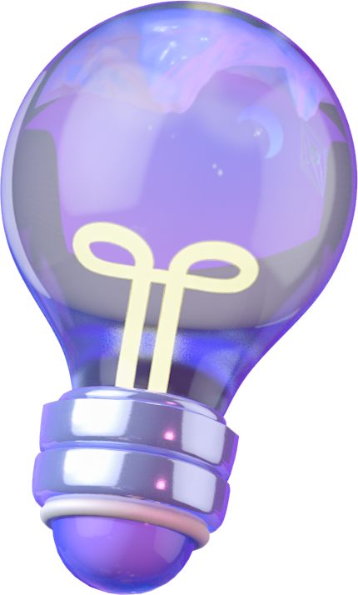
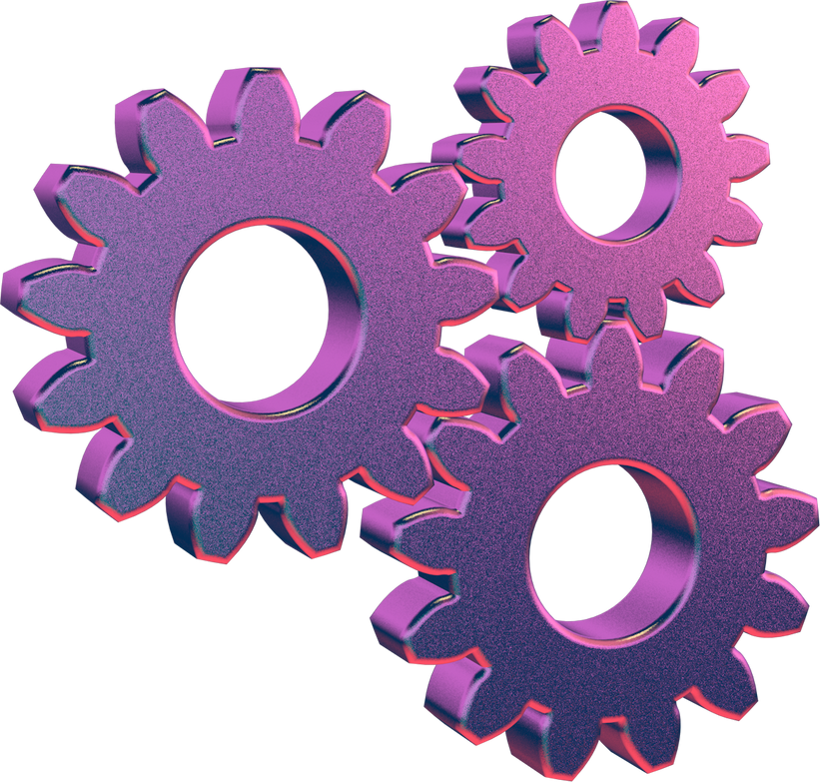
OUR APPLICATION
Page 07

Slide 9
Final App Overview
Our final app version is now fully functional and tested. It provides a comprehensive platform for users to manage their health and lifestyle efficiently, offering:
Personalized experiences
Real-time feedback via AI
Integration with daily habits
The app is available in both Arabic and English, with a clean, responsive UI optimized for mobile use.
Page 08

Slide 10
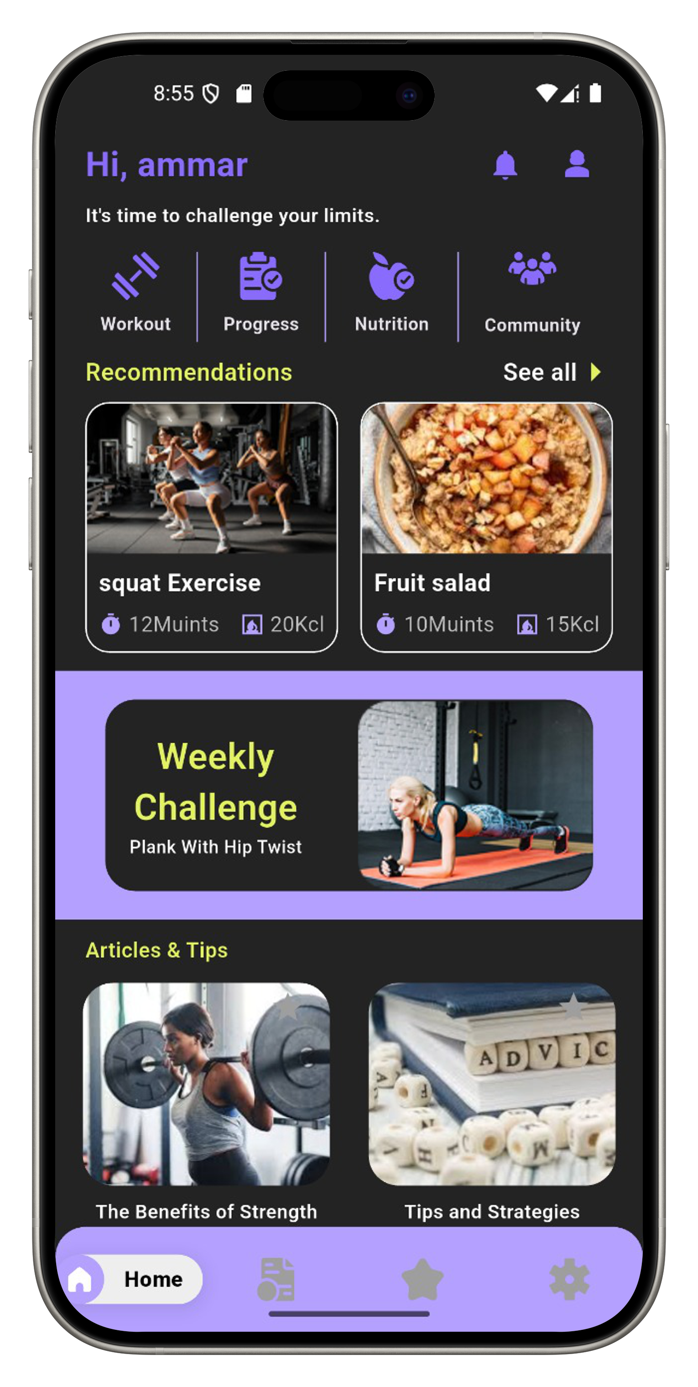
Home Page Overview – App Main Dashboard
The Home Page is the heart of the app. It acts like a central hub where the user can access everything in one place — from health stats to smart tools and recommendations.
1. Top Section – Welcome Message & Profile
Shows the user’s name and profile picture
Motivational message like: “Welcome back, Mahmoud! Let’s crush your goals today!”
Quick access to edit profile and update personal data (BMI, weight, goals)

Slide 11
2. Health Summary Cards
These cards provide a snapshot of the user’s current health metrics:
BMI Status (Normal / Overweight / Obese)
Steps Taken Today (synced from Google Fit / Apple Health)
Water Intake Tracker – progress bar with reminder option
Calories Burned – calculated based on activity
Each card is color-coded and uses icons for quick visualization.
Page 04

Slide 12
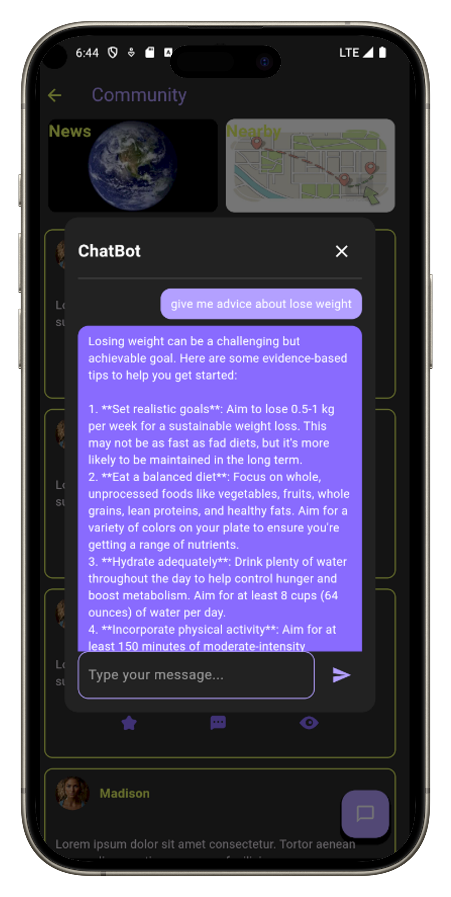
3. AI Chatbot Shortcut
A floating button or fixed section: “Ask our AI anything”
Clicking it opens a smart chat interface Examples:
“What should I eat for dinner?”
“Recommend an ab workout.”
“How many calories should I consume today?”
This feature enhances interactivity and replaces typical navigation.

Slide 13
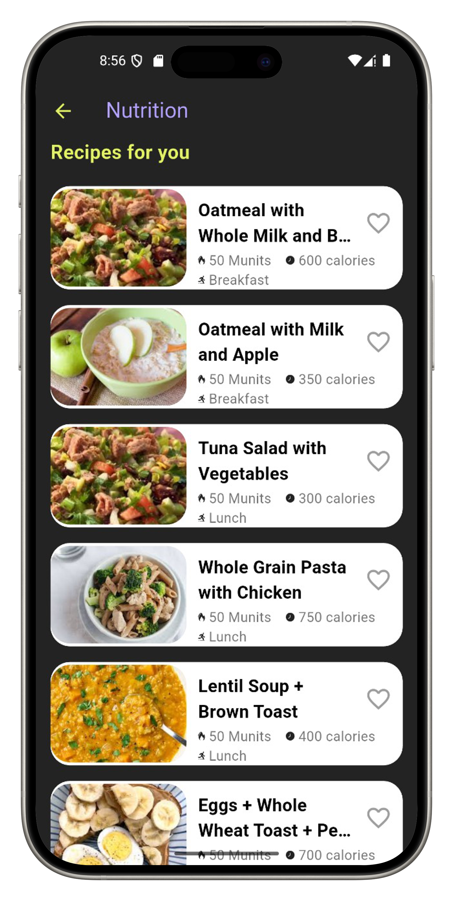
4. Today’s Meal Plan
Shows breakfast, lunch, dinner, and snacks with calories
Based on user preferences, health condition, and daily goal
Swipeable cards or expandable list with:
Meal image
Calories
Macronutrients
Option to mark as “eaten”
Users can request to regenerate meals if needed.

Slide 14
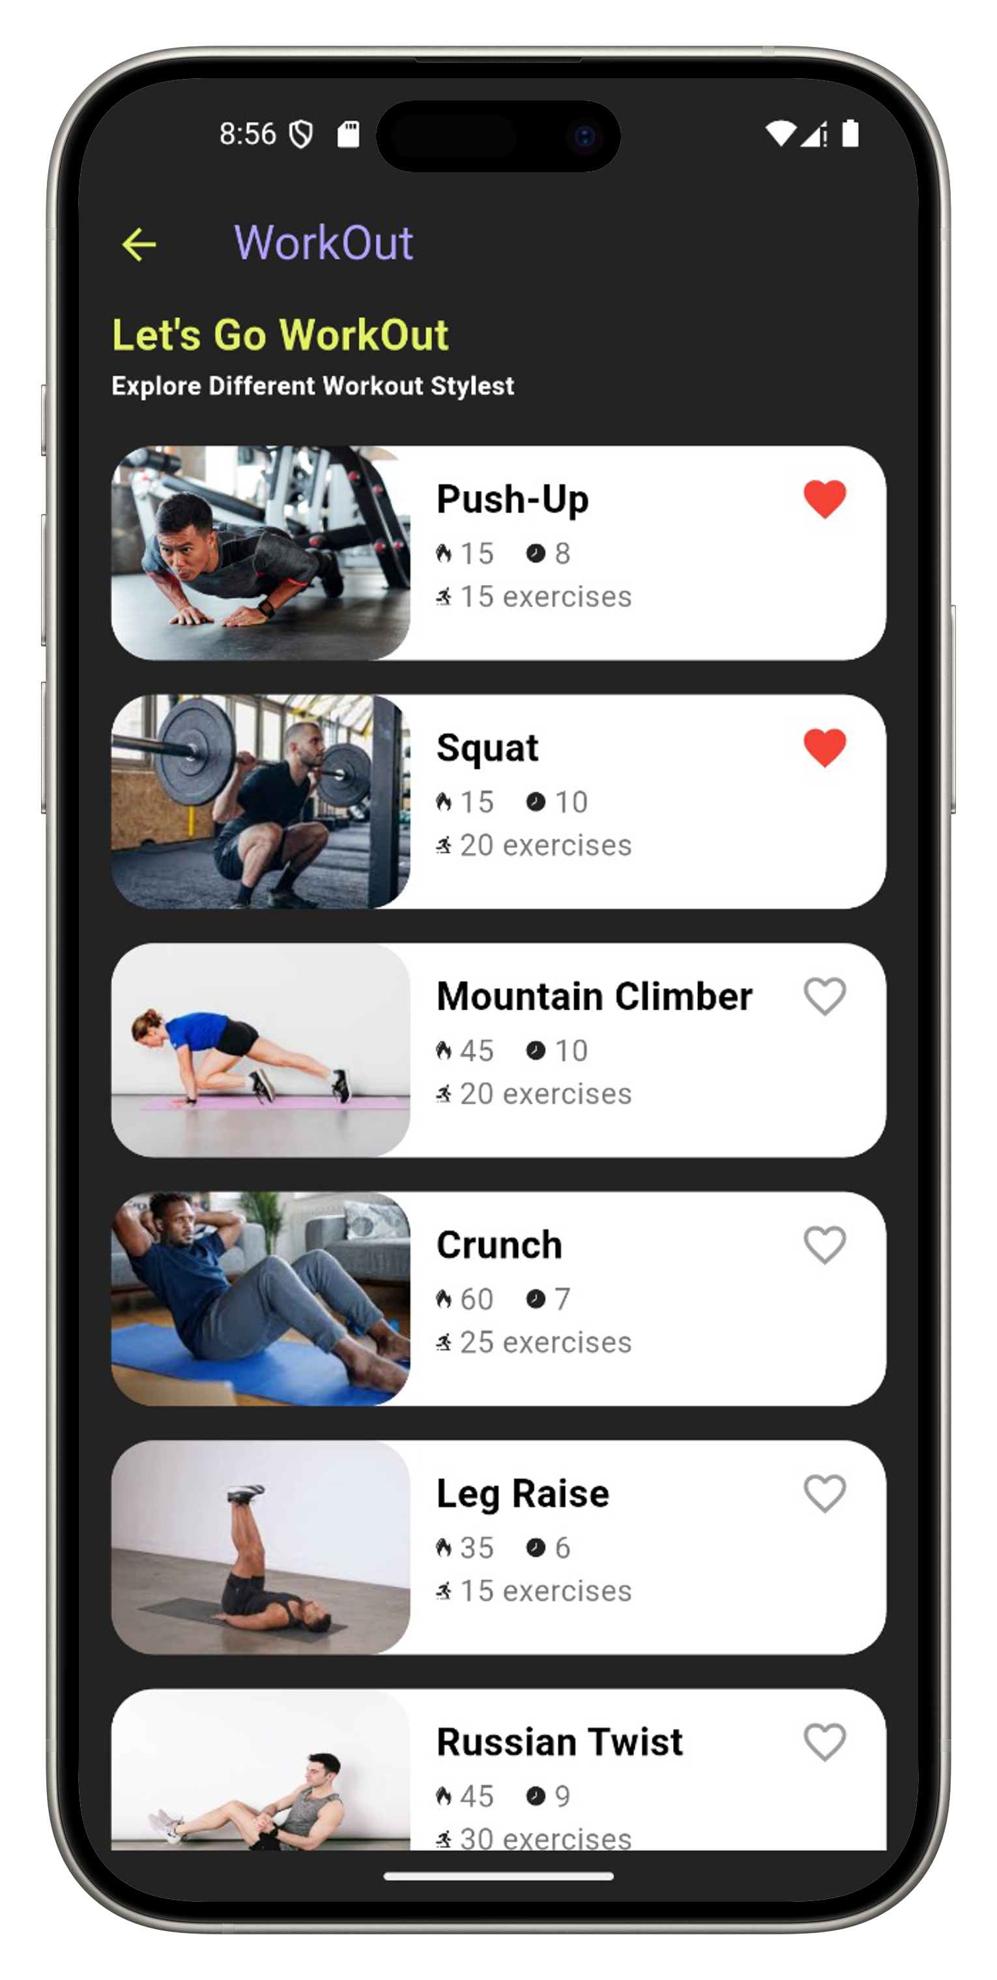
5. Workout Plan Preview
Daily workout preview section
"Start Now" button launches the routine
Can include animations or tips for each workout
Exercise level shown (Beginner / Intermediate / Advanced)
Tracks reps, sets, and duration automatically.

Slide 15
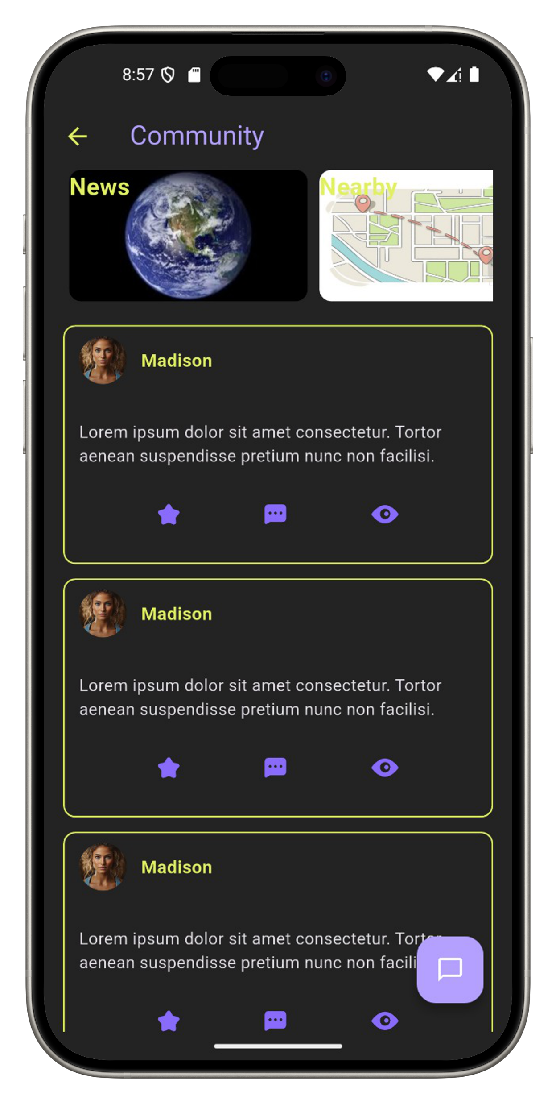
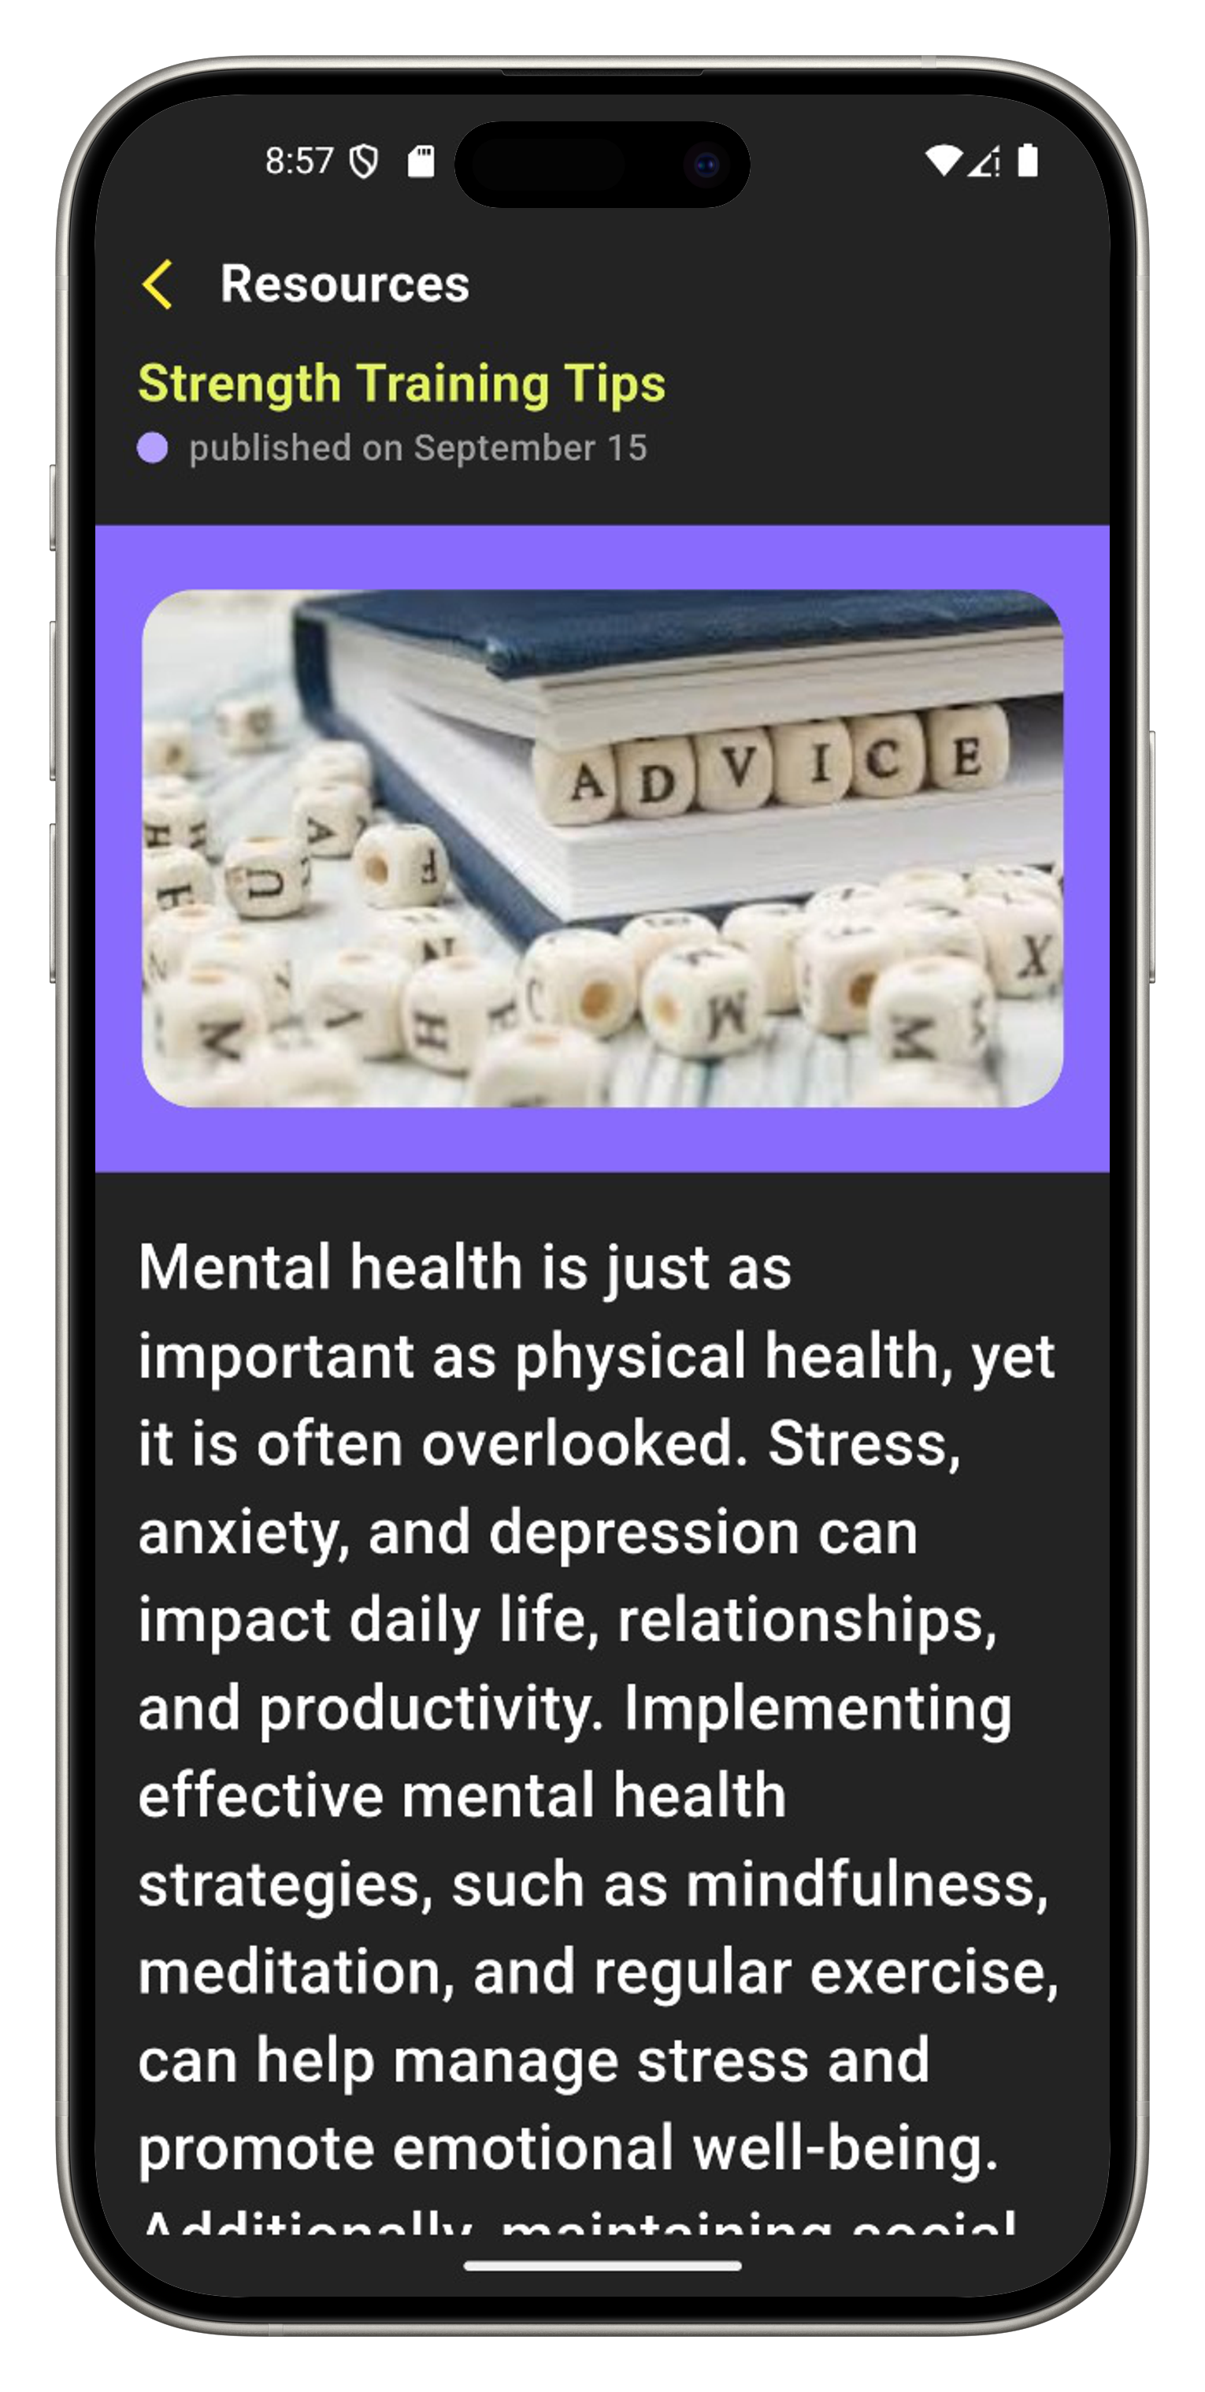
6. Health News Feed
Latest health and fitness news from trusted sources
Scrollable section with articles:
“5 Best Foods for Fat Loss”
“How Sleep Affects Your BMI”
Encourages daily engagement and awareness

Slide 16
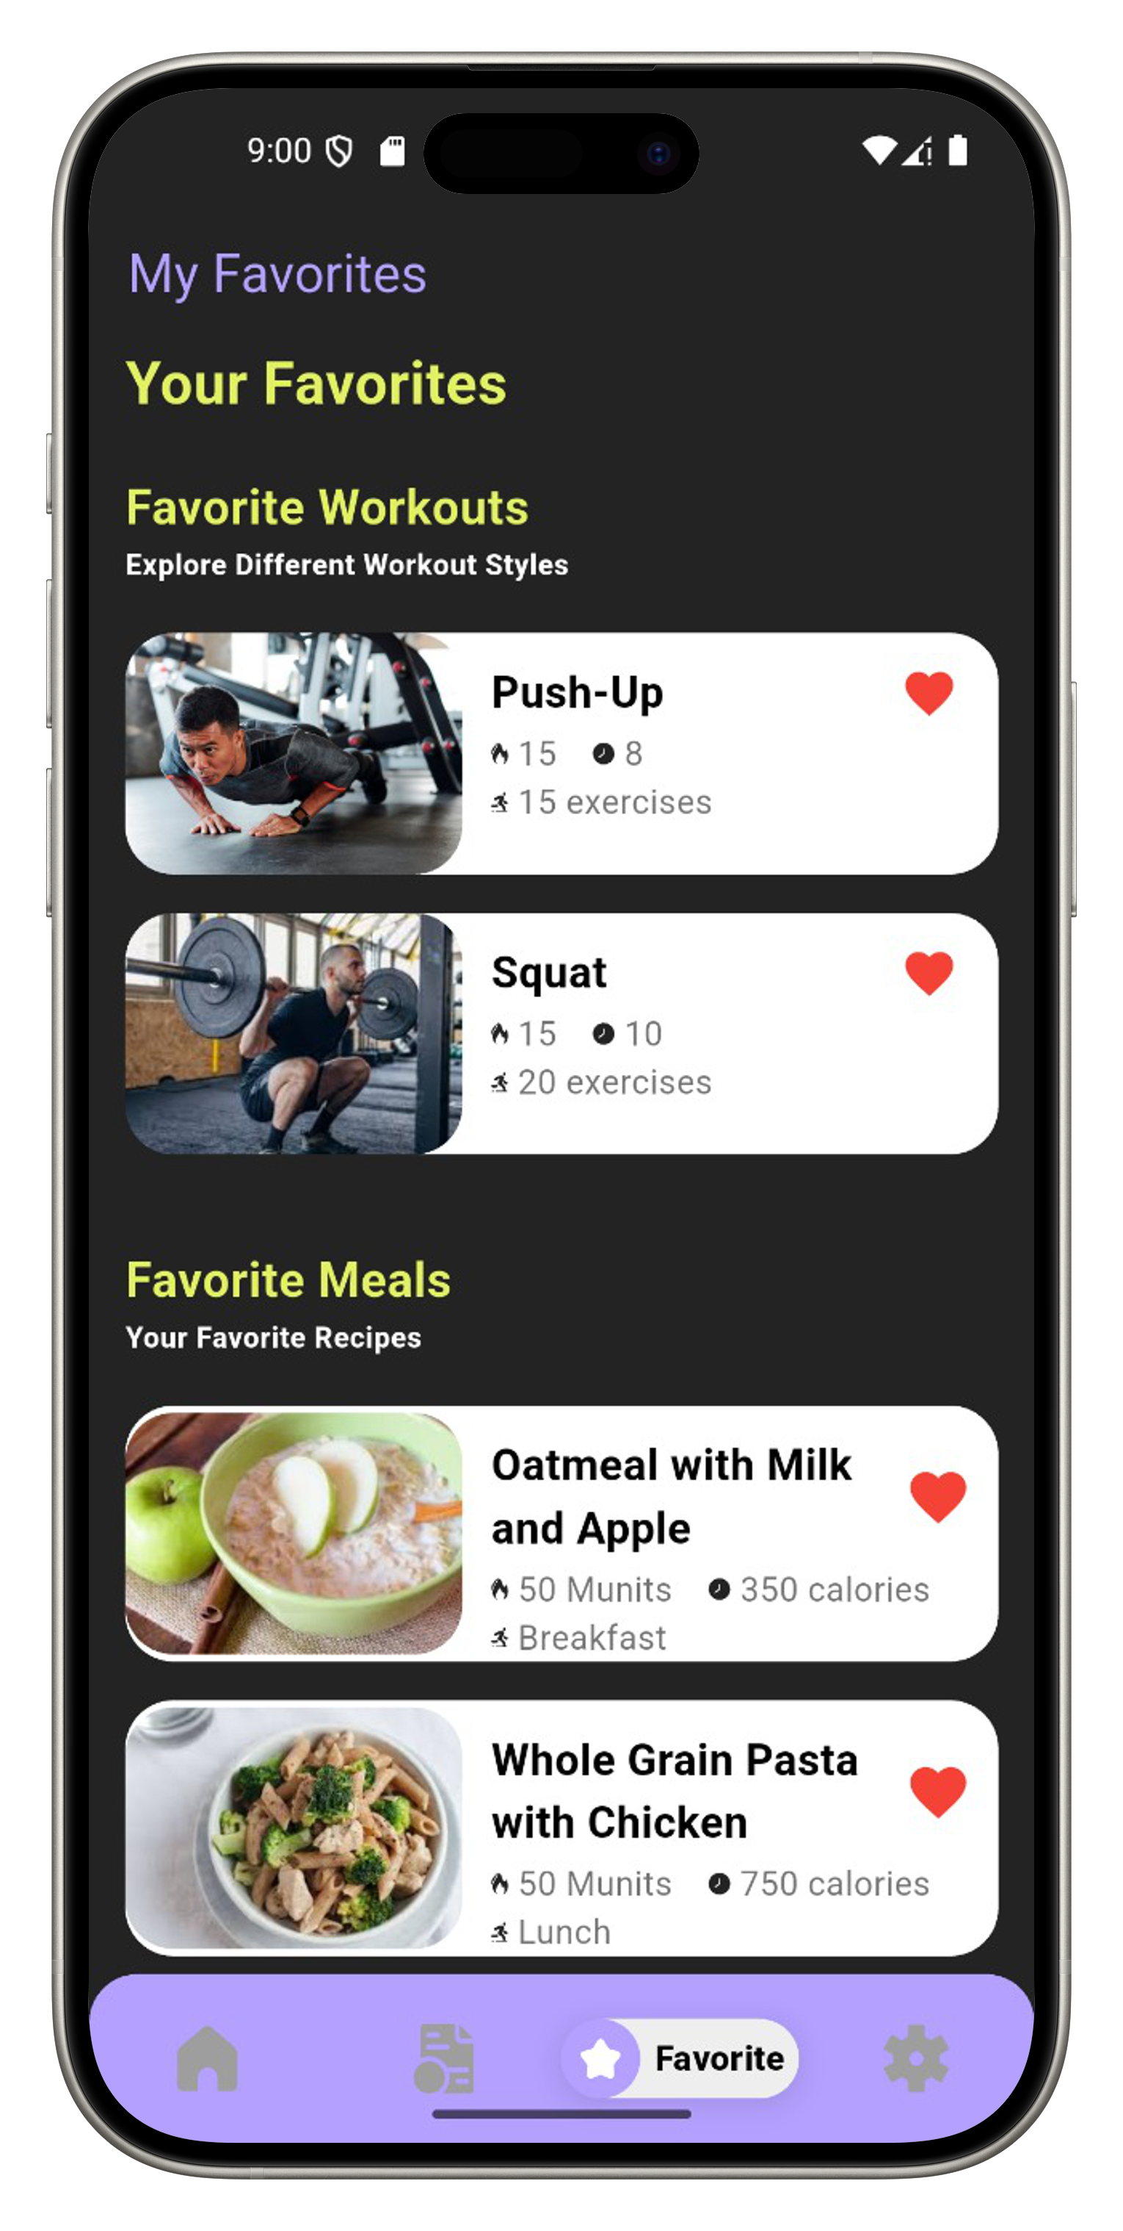
7. Favorites Section
Allows users to save their favorite meals, workouts, and health articles for quick access at any time
Organized into clear categories: Meals – Workouts – News, making navigation easy and personalized
Useful for users who follow a consistent routine or want to repeat plans they like
Includes filtering options by type, calories, or time, and supports reordering or deleting items
Helps create a custom health experience that grows with the user's preferences and goals
Encourages users to stay engaged with the content that works best for them

Slide 17
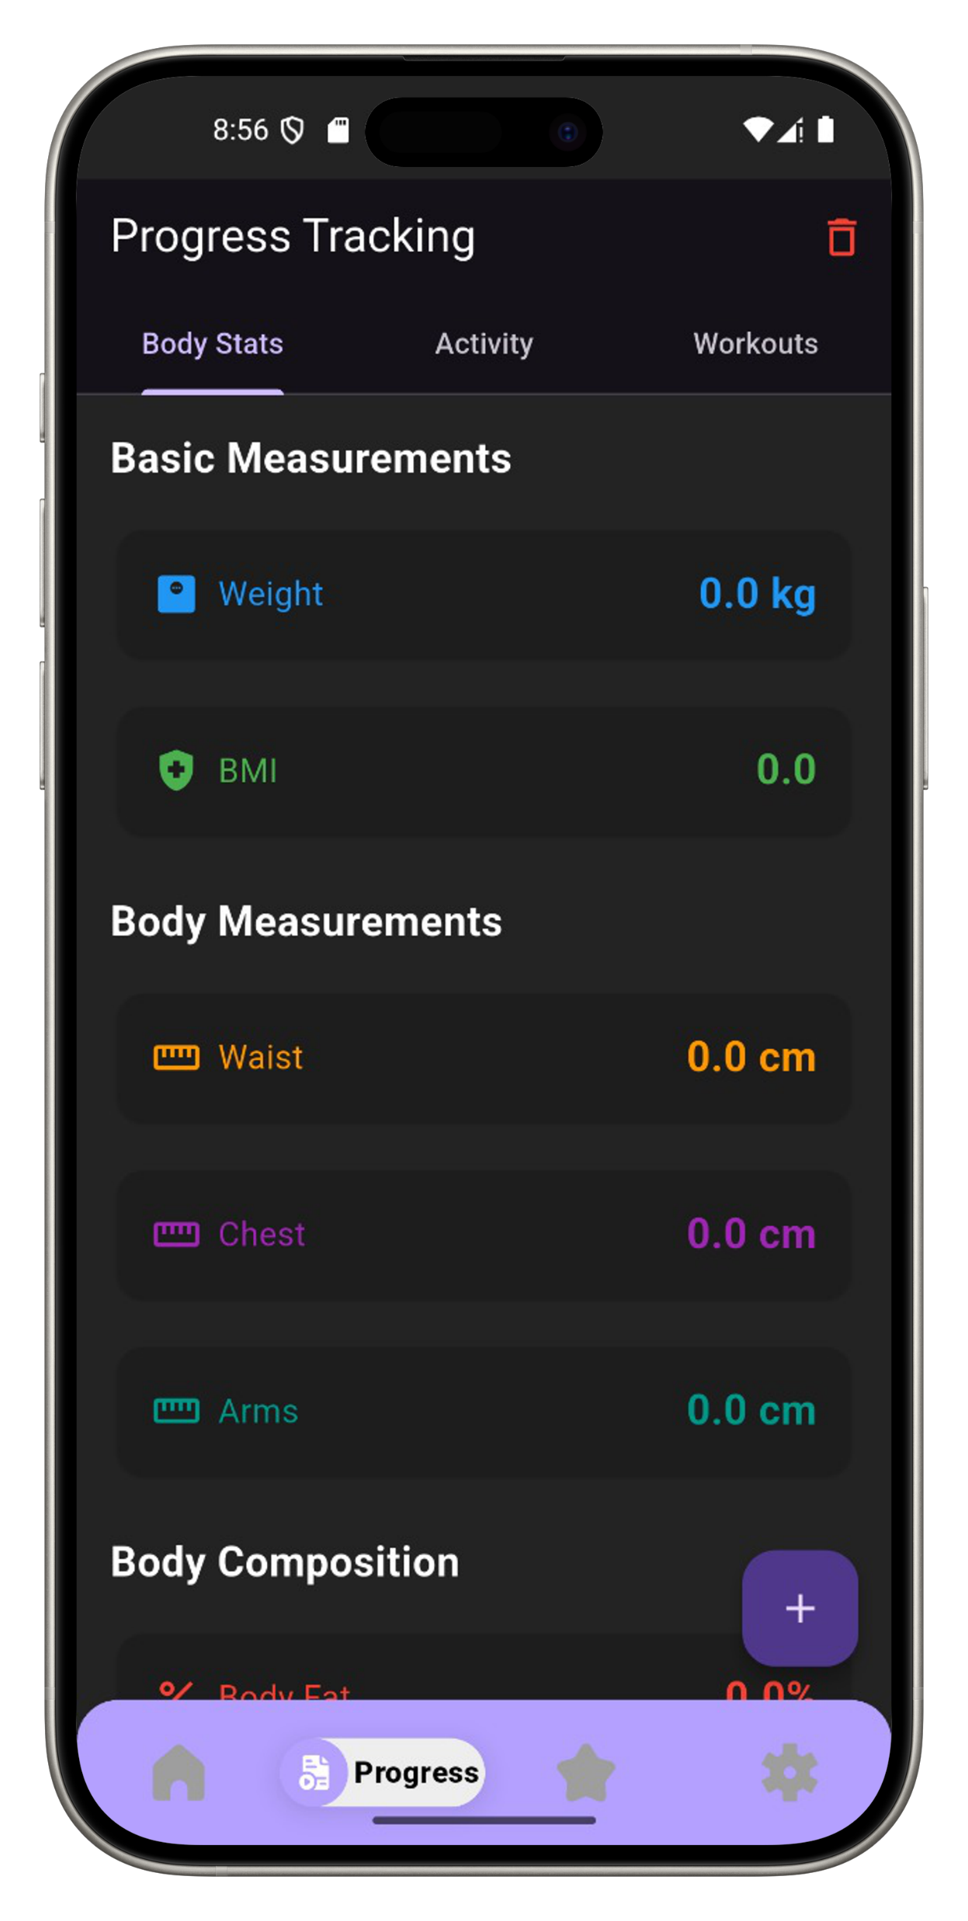
8. Progress Tracking
Enables users to track key health indicators such as BMI, weight changes, calories burned, water intake, and workout frequency
Provides visual representations like line graphs, circular progress bars, and weekly summary cards for better clarity
Shows goal achievement status over time and helps users measure their improvements

Slide 18
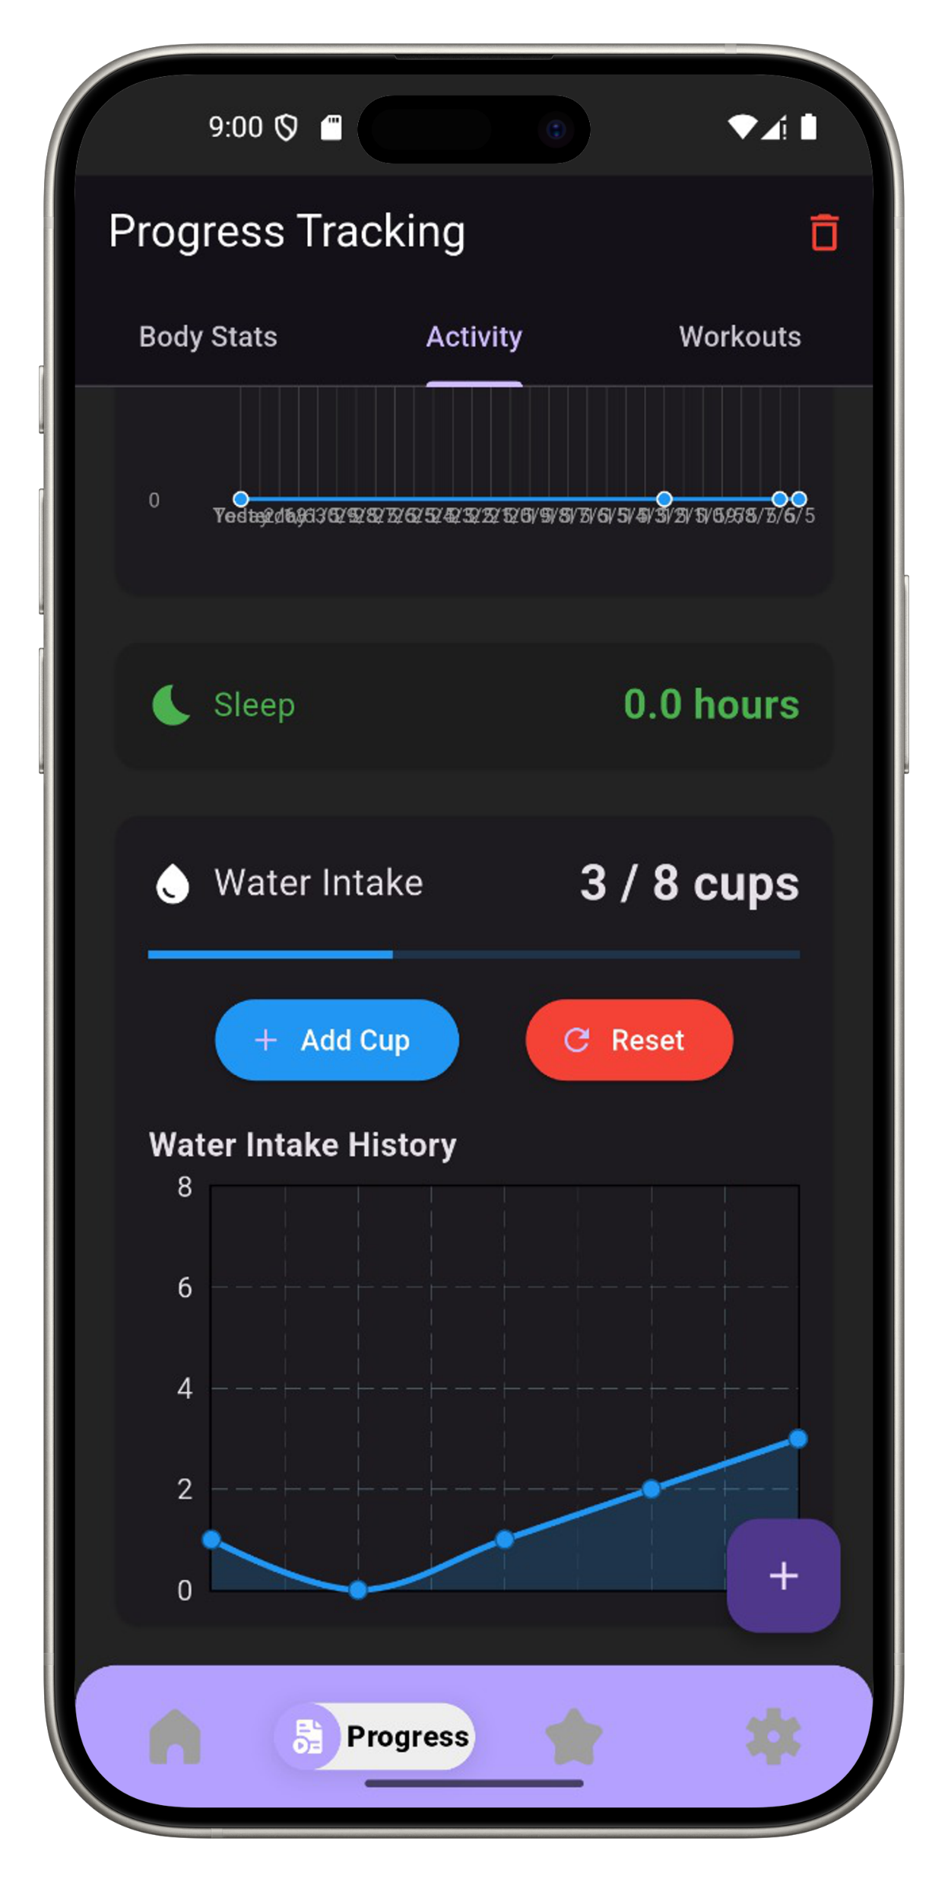
Motivates users to stay consistent with streak counters and milestone badges
Supports smart adjustments by analyzing progress trends, allowing for goal modifications when needed
A valuable tool for self-monitoring and long-term success in lifestyle improvement

Slide 19
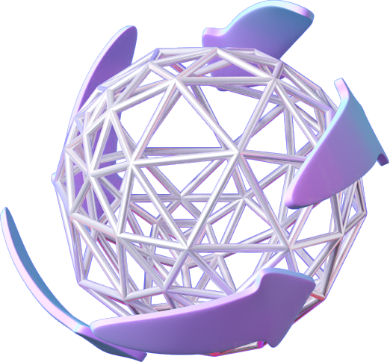
OUR
WEBSITE
Page 05

Slide 20
Purpose:
To introduce users to the main idea and benefits of the app
To showcase the app’s core features and how it works
To guide users through the functionality before downloading the app
What's on the Website:
A clear overview of the app’s purpose: improving health and lifestyle using AI
Detailed sections explaining each feature (meal planning, workouts, chatbot, tracking, etc.)
Screenshots and mockups showing how the app looks and functions
Step-by-step instructions on how to use the app effectively
FAQs to help users understand how to get started and solve common issues

Slide 21
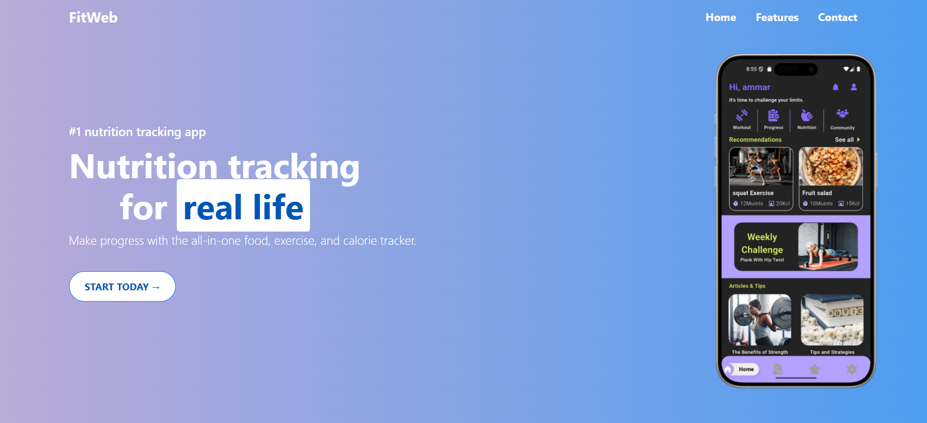
The website is designed with a modern, responsive layout and supports both Arabic and English, ensuring easy access and understanding for all users. It acts as a bridge between users and the app, helping them explore its value before installation

Slide 22
Conclusion
Our Ai Powered Personal Fitness & Lifestyle Advisor integrates AI and Machine Learning to provide personalized health insights.
High model accuracy ensures reliable BMI classification and recommendations.
The intuitive UI enhances user experience and accessibility.
The diet recommendation system ensures tailored meal plans for better health and lifestyle improvements.
This project represents a significant step in digital healthcare, helping users adopt healthier habits with AI-driven solutions.

Slide 23
Team Members
Ahmed Ehab Elbadry
Ahmed Ayman Kamal
Fares Alaa Fawzy
Amar Yasser Mohamed
Mohamed Tarek Abo-Alhamd
Nada Yasser Kamal
Rana Abdelaal Ali

Slide 24
THANK YOU
Page 10

